Slide 1

Data Structure
Unit 1
Array
Department of Computer Engineering
BRACT’S, Vishwakarma Institute of Technology, Pune-37
(An Autonomous Institute affiliated to Savitribai Phule Pune University)
(NBA and NAAC accredited, ISO 9001:2015 certified)

Slide 2
Syllabus of this Subject
Unit 1:Arrays | Unit 2: Linked Lists
Algorithms: Asymptotic Notations, Time and Space Complexity Arrays: Introduction, Memory Representation and application of Single and Multidimensional arrays, Sparse Matrix. Searching and sorting techniques: Linear Search, Binary search with Analysis. Sorting Techniques: Bubble Sort, Insertion Sort, Merge Sort, Quick Sort with Analysis and passes. | Dynamic memory allocation, Singly Linked Lists, Doubly linked Lists, Circular linked lists and Generalized linked lists, Applications of Linked list, introduction to Vectors and Application.
Unit 3: Stacks and Queues | Unit 4: Trees
Stack: Stack representation and Implementation using arrays and Linked lists. Applications of stack in Recursion, Expression conversions and evaluations. Queues: Representation and implementation using array and Linked lists, Types of queue. Applications of Queues: Job Scheduling, Josephus problem etc. | Basic terminology, representation using array and linked lists. Tree Traversals: Recursive and Non recursive, Operations on binary tree. Binary Search trees (BST).
Department of Computer engineering, VIT, Pune- 411037

Slide 3
Syllabus of this Subject
Unit 5: Graphs | Unit 6: Hashing
Terminology and representation using Adjacency Matrix and Adjacency Lists, Graph Traversals and Application: BFS and DFS, Connected graph, Bipartite Graph, Detecting Cycle in graph. Minimum Spanning tree: Prims and Kruskal’s Algorithm, Shortest Path Algorithms, Union Find. | Hashing techniques, Hash table, Hash functions. Collision handling and Collision resolution techniques.
Mr. Vikas Maral, Department of Computer engineering, VIT, Pune- 411037

Slide 4
Objective/s of this session
Understand Basic Concept of Programming
To Understand Concept of Data Structure and its types .
1. Differentiate Data structure and analyze and synthesize time and space complexity of algorithm.
Learning Outcome/Course Outcome
Mr. Vikas Maral, Department of Computer engineering, VIT, Pune- 411037

Slide 5
Session Content
Algorithms (Logic Building)
Asymptotic Notation
Data Structure
Types of Data Structure
Linear vs. Non- Linear, Static vs. Dynamic, Persistent vs. Ephemeral
Mr. Vikas Maral, Department of Computer engineering, VIT, Pune- 411037

Slide 6
What is Data Structure
DSA is defined as a combination of two separate yet interrelated topics: Data Structure and Algorithms.
Data Structure:
Way to arrange Data in main Memory for efficient way A data structure is defined as a particular way of storing and organizing data in our devices to use the data efficiently and effectively. The main idea behind using data structures is to minimize the time and space complexities. An efficient data structure takes minimum memory space and requires minimum time to execute the data.
Algorithms
Algorithm is defined as a process or set of well-defined instructions that are typically used to solve a particular group of problems or perform a specific type of calculation. To explain in simpler terms, it is a set of operations performed in a step-by-step manner to execute a task.
Mr. Vikas Maral, Department of Computer engineering, VIT, Pune- 411037

Slide 7
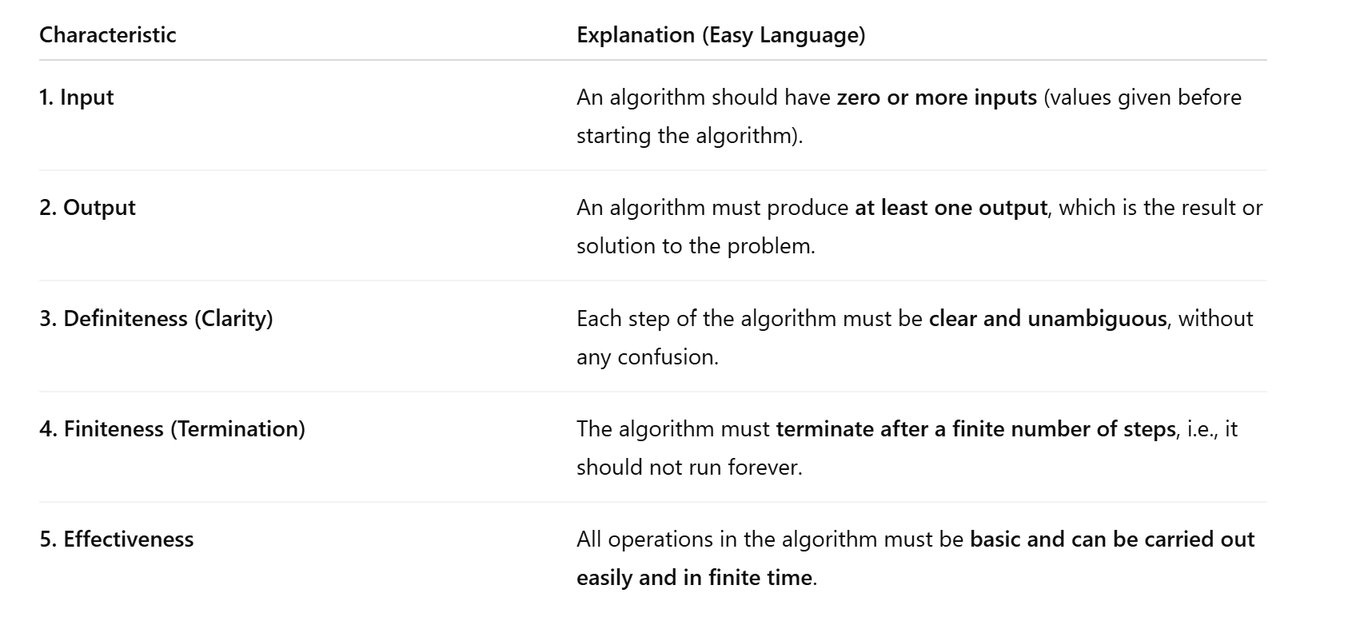
What is Data Structure
Algorithms
An algorithm is a step-by-step procedure or set of rules to solve a specific problem in a finite amount of time
Mr. Vikas Maral, Department of Computer engineering, VIT, Pune- 411037

Slide 8
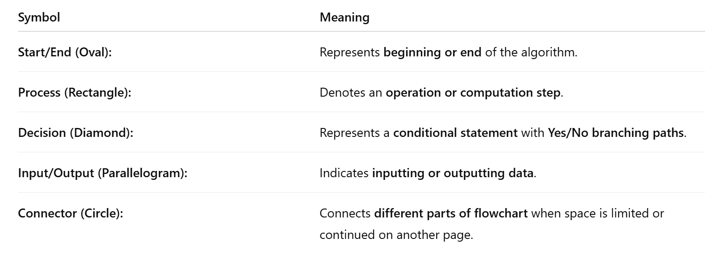
Algorithm Design Tools: Flowcharts and Pseudocode
A flowchart is a visual representation of an algorithm using symbols and shapes to illustrate the steps and logical flow of a process.
Mr. Vikas Maral, Department of Computer engineering, VIT, Pune- 411037

Slide 9
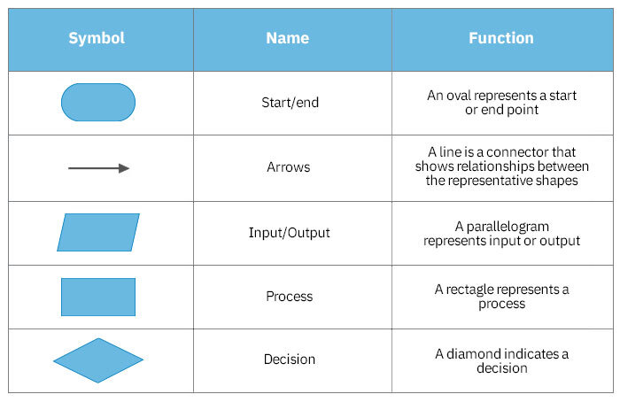
Algorithm Design Tools: Flowcharts and Pseudocode
Mr. Vikas Maral, Department of Computer engineering, VIT, Pune- 411037

Slide 10
Algorithm Design Tools: Flowcharts and Pseudocode
Advantages of Flowchart:
Visual Representation: Easy to understand and follow.
Structured Design: Facilitates systematic problem-solving.
Documentation: Useful for explaining and recording algorithms.
Disadvantages of Flowcharts
Limited Detail: May not capture complex programming logic fully.
Space Constraints: Large algorithms may require significant space and become cluttered.
Mr. Vikas Maral, Department of Computer engineering, VIT, Pune- 411037

Slide 11
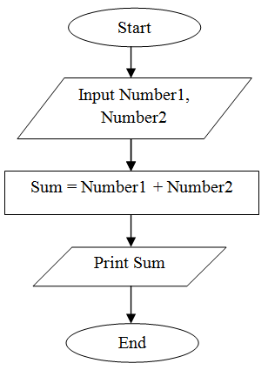
Algorithm Design Tools: Flowcharts and Pseudocode
Mr. Vikas Maral, Department of Computer engineering, VIT, Pune- 411037

Slide 12
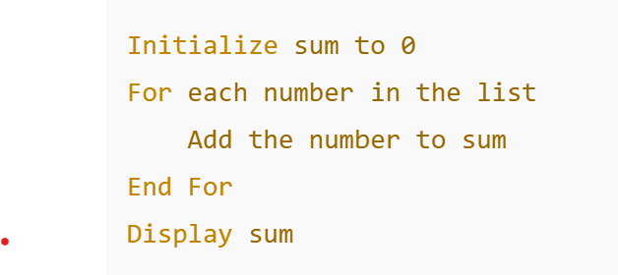
Algorithm Design Tools: Flowcharts and Pseudocode
Pseudocode is a simple way to write the steps of a program or algorithm using plain English mixed with programming ideas. It is not an actual programming language, but it helps you plan your code before writing it.
Key Elements:
Variables: Used to represent data.
Operations: Basic operations like assignments, arithmetic, and comparisons.
Control Structures: If-else statements, loops, and conditional constructs.
Functions/Procedures: Representing modular parts of the algorithm.
Examples: Calculate the sum of numbers in a list.
Mr. Vikas Maral, Department of Computer engineering, VIT, Pune- 411037

Slide 13
Homework on Algorithms Desing Tool
Design a flowchart and write pseudocode to sum of two number
Design a flowchart and write pseudocode for area of Square
Design a flowchart and write pseudocode Min and Max from 2 Number
Design a flowchart and write pseudocode to check whether a given number is even or odd
Design a flowchart and write pseudocode to Calculate Sum of N Natural Numbers
Design a flowchart and write pseudocode to Calculate Factorial of a Number
Design a flowchart and write pseudocode to Is number is Prime or not
Mr. Vikas Maral, Department of Computer engineering, VIT, Pune- 411037

Slide 14
Asymptotic Notation
Asymptotic notation is used to describe the running time or space requirement of an algorithm in terms of input size (n), particularly when n becomes very large.
It gives a mathematical way to compare algorithm efficiency, ignoring machine-dependent constants and lower order terms.
Why do we need it?
We want to know which algorithm is faster when data is huge.
We ignore small differences and focus only on growth rate.
There are mainly three asymptotic notations:
Big-O notation
Omega notation
Theta notation
Mr. Vikas Maral, Department of Computer engineering, VIT, Pune- 411037

Slide 15
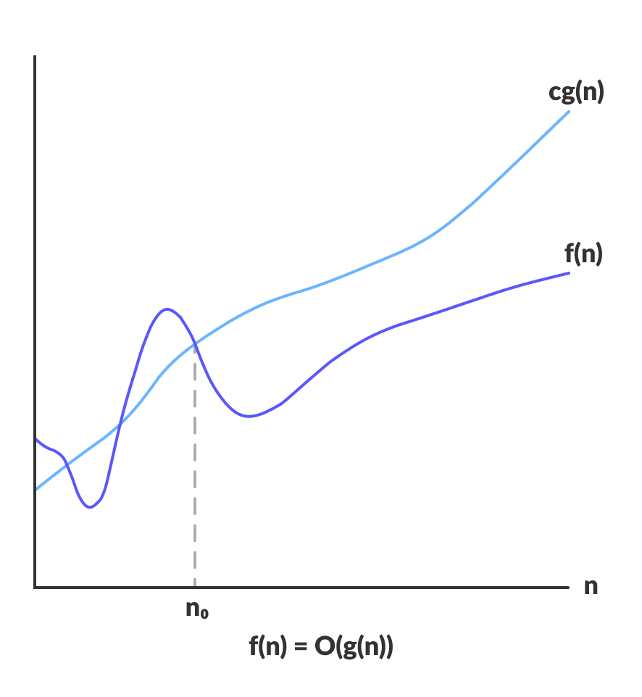
Asymptotic Notation
The efficiency of an algorithm depends on the amount of time, storage and other resources required to execute the algorithm. The efficiency is measured with the help of asymptotic notations.
Big-O Notation (O-notation): Big-O notation represents the upper bound of the running time of an algorithm. Thus, it gives the worst-case complexity of an algorithm.
O(g(n)) = { f(n): there exist positive constants c and n₀ such that 0 ≤ f(n) ≤ cg(n) for all n ≥ n₀ }
Mr. Vikas Maral, Department of Computer engineering, VIT, Pune- 411037

Slide 16
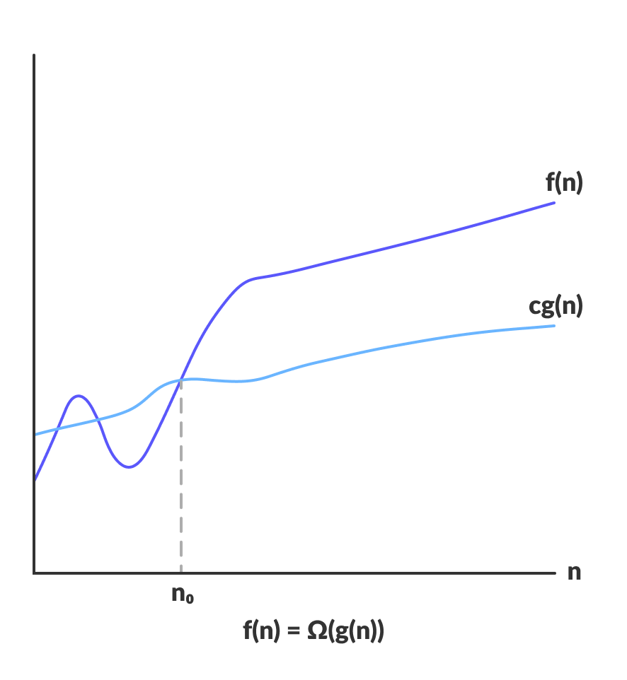
Asymptotic Notation
Omega Notation (Ω-notation): Omega notation represents the lower bound of the running time of an algorithm. Thus, it provides the best case complexity of an algorithm.
Ω(g(n)) = { f(n): there exist positive constants c and n₀ such that 0 ≤ cg(n) ≤ f(n) for all n ≥ n₀ }
Mr. Vikas Maral, Department of Computer engineering, VIT, Pune- 411037

Slide 17
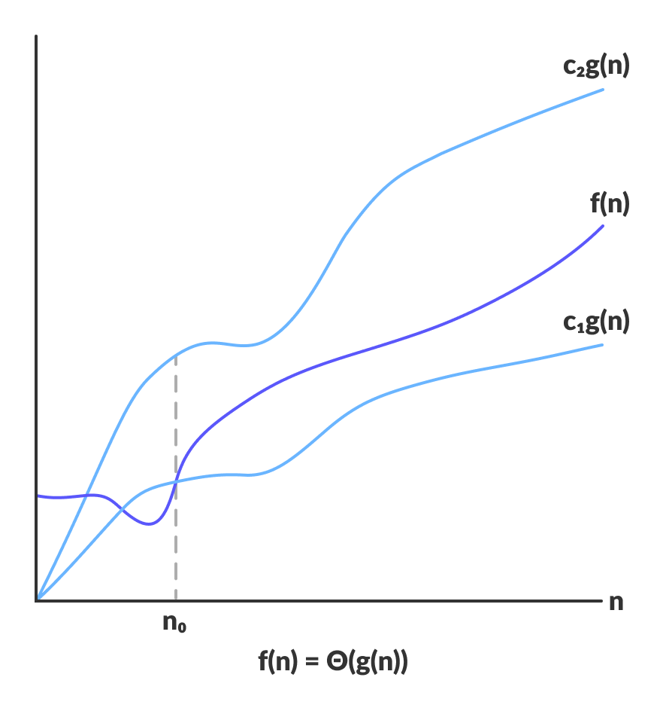
Asymptotic Notation
Theta Notation (Θ-notation): Theta notation encloses the function from above and below. Since it represents the upper and the lower bound of the running time of an algorithm, it is used for analyzing the average-case complexity of an algorithm.
Θ(g(n)) = { f(n): there exist positive constants c₁, c₂ and n₀ such that 0 ≤ c₁g(n) ≤ f(n) ≤ c₂g(n) for all n ≥ n₀ }
Mr. Vikas Maral, Department of Computer engineering, VIT, Pune- 411037

Slide 18
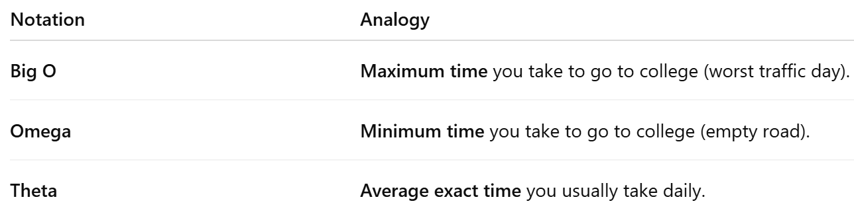
Asymptotic Notation
Mr. Vikas Maral, Department of Computer engineering, VIT, Pune- 411037

Slide 19
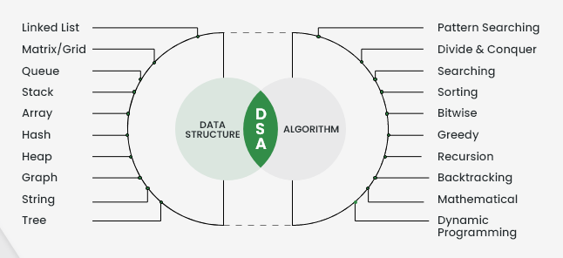
What is Data Structure
A data structure is a way of storing and organizing data in computer memory so that it can be used efficiently.
To organise data systematically
To perform operations like searching, sorting, and updating quickly
To save memory and time, making programs efficient
For better problem solving in programming and real-life applications
Mr. Vikas Maral, Department of Computer engineering, VIT, Pune- 411037

Slide 20
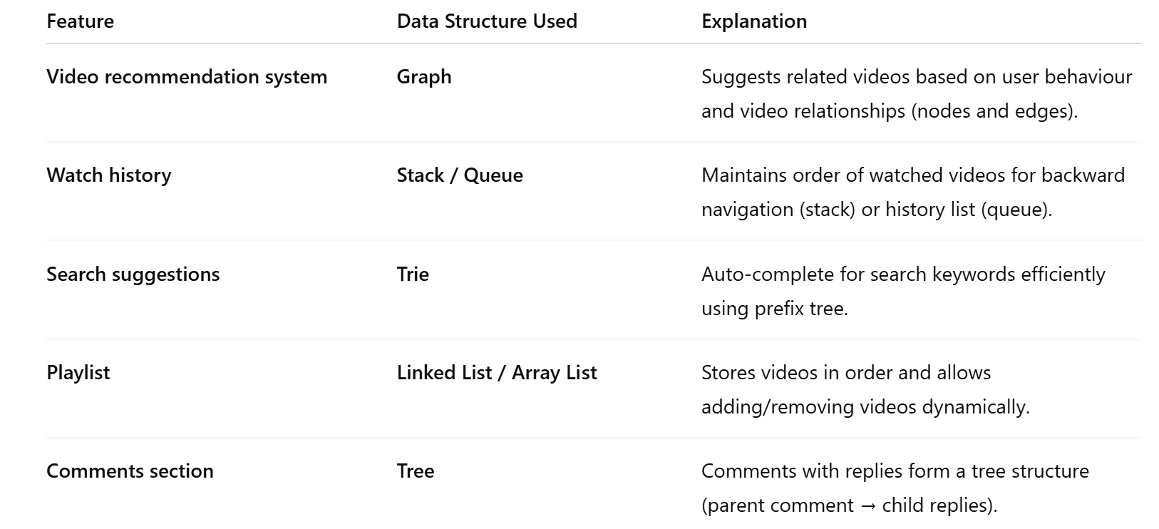
Real Time Application of Data Structure
Mr. Vikas Maral, Department of Computer engineering, VIT, Pune- 411037

Slide 21
Classification Of Data Structures
Data Structures
Primitive Data Structures
Non-Primitive Data Structure
Integer
Float
Character
Pointer
Linear Data Structure
Non-Linear Data Structure
Array
Linked List
Stack
Queue
Tree
Graph
Files
Mr. Vikas Maral, Department of Computer engineering, VIT, Pune- 411037

Slide 22
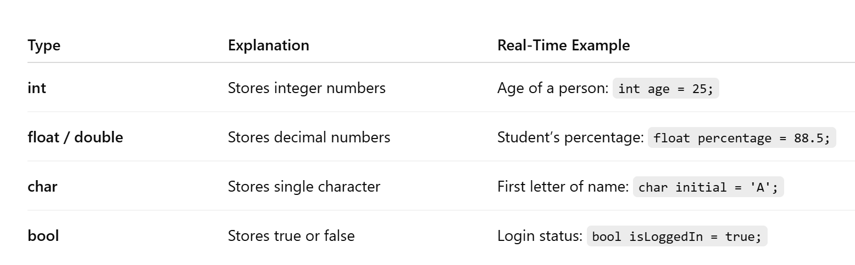
Primitive Data Structure:
These are basic data types provided by programming languages as building blocks.
Mr. Vikas Maral, Department of Computer engineering, VIT, Pune- 411037

Slide 23
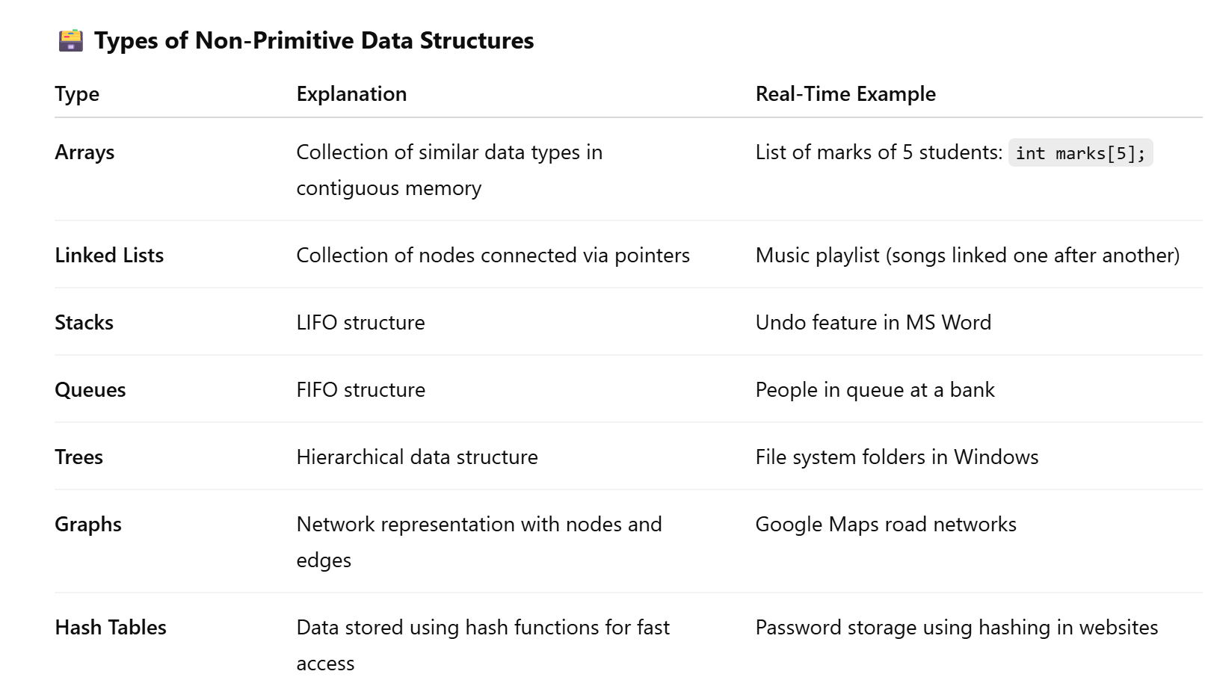
Non- Primitive Data Type:
These are complex data structures built using primitive types, used to organize and manage large data efficiently.
Mr. Vikas Maral, Department of Computer engineering, VIT, Pune- 411037

Slide 24
Sr. No. | Key | Linear Data Structures | Non-linear Data Structures
1 | Definition | Basic built-in data types provided by programming languages. | Complex data structures derived from primitive types to store large and connected data efficiently.
2 | Examples | int, char, float, double, bool | Arrays, Linked Lists, Stacks, Queues, Trees, Graphs, Hash Tables
3 | Nature | Simple, atomic data items | Can be linear (array, linked list) or non-linear (tree, graph)
4 | Operations | Directly operated by machine instructions | Requires user-defined operations and implementation logic
5 | Memory Size | Fixed size depending on data type | Size can be fixed (array) or dynamic (linked list, tree)
Mr. Vikas Maral, Department of Computer engineering, VIT, Pune- 411037

Slide 25
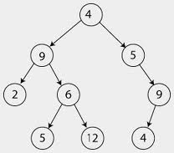
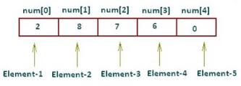

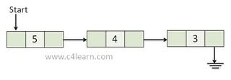
Sr. No. | Key | Linear Data Structures | Non-linear Data Structures
6 | Memory utilization | Linear data structures are not very memory friendly and are not utilizing memory efficiently. | Non-linear data structures uses memory very efficiently.
7 | Time Complexity | Time complexity of linear data structure often increases with increase in size. | Time complexity of non-linear data structure often remain with increase in size.
8 | Examples | Array Linked List | Tree Graph
Mr. Vikas Maral, Department of Computer engineering, VIT, Pune- 411037

Slide 26
Static data structure
The size of the structure is fixed.
The content of the data structure can be modified but without changing the memory space allocated to it.
provides more easier access to elements with respect to dynamic data structure
Example of Static Data Structures: Array( int a[5] )
Dynamic data structure
The size of the structure in not fixed and can be modified during the operations performed on it.
Dynamic data structures are designed to facilitate change of data structures in the run time.
flexible
Example of Dynamic Data Structures: Linked List
Mr. Vikas Maral, Department of Computer engineering, VIT, Pune- 411037

Slide 27
Persistent data structure
data structure that always preserves the previous version of itself when it is modified.
immutable, as their operations do not (visibly) update the structure in-place, but instead always yield a new updated structure.
A data structure is partially persistent if all versions can be accessed but only the newest version can be modified.
The data structure is fully persistent if every version can be both accessed and modified.
Mr. Vikas Maral, Department of Computer engineering, VIT, Pune- 411037

Slide 28
Ephemeral data structure
An ephemeral data structure is one for which only one version is available at a time: after an update operation, the structure as it existed before the update is lost.
mutable, as their operations update the structure in-place, so new updated structure can be accessed and modified .
In imperative languages, most data structures are ephemeral. a=5,15
Persistent structure
multiple versions are simultaneously accessible: after an update, both old and new versions can be used.
immutable, as their operations do not (visibly) update the structure in-place, but instead always yield a new updated structure. So old and new updated structure can be accessed and modified .
In functional languages, data structures are persistent
Mr. Vikas Maral, Department of Computer engineering, VIT, Pune- 411037
Notes:
The canonical examples of imperative programming languages are Fortran and Algol. Others include Pascal, C, and Ada .
Some of the popular functional programming languages include: Lisp, Python, Erlang, Haskell, Clojure,

Slide 29
Types of Array
A one-dimensional array is a data structure that stores elements of the same type in a linear sequence. It's a fundamental concept in computer programming and is widely used in various algorithms and applications.
In a one-dimensional array:
Elements: Elements are stored sequentially in memory.
Indexing: Each element is accessed using its index, which represents its position in the array. The index typically starts from 0 or 1, depending on the programming language.
Size: The size of the array is fixed at the time of declaration in most programming languages, although dynamic arrays are available in some languages like C++.
Mr. Vikas Maral, Department of Computer engineering, VIT, Pune- 411037

Slide 30
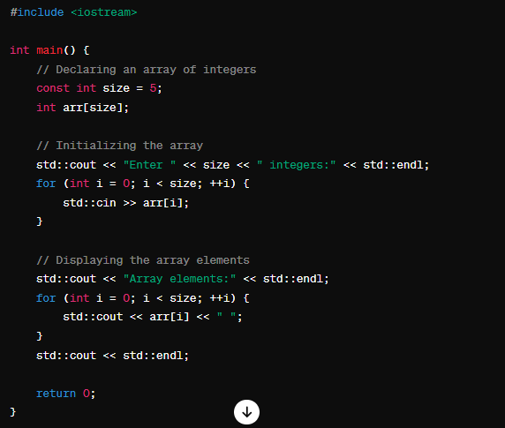
1D Array
Mr. Vikas Maral, Department of Computer engineering, VIT, Pune- 411037

Slide 31
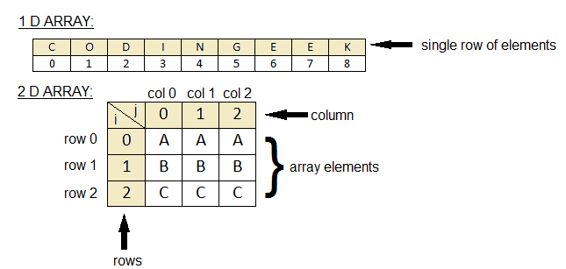
Array implementation of a List
Mr. Vikas Maral, Department of Computer engineering, VIT, Pune- 411037

Slide 32
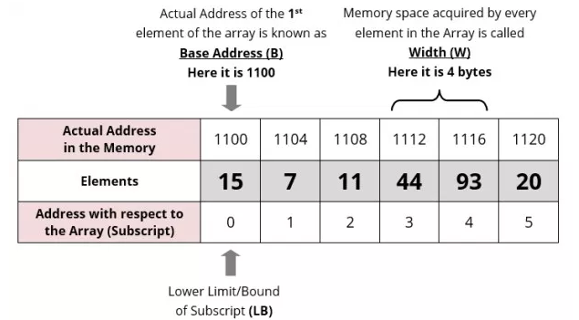
Storage representation of 1D Array
Mr. Vikas Maral, Department of Computer engineering, VIT, Pune- 411037

Slide 33
Address Calculation in 1D Array
Address of an element of an array say “A[ I ]” is calculated using the following formula:
Address of A [ I ] = B + W * ( I – LB )
Where,
B = Base address
W = Storage Size of one element stored in the array (in byte)
I = Index of element whose address is to be found
LB = Lower limit / Lower Bound of subscript, if not specified assume 0 (zero) This specifies the starting index of the array. If not specified, it's assumed to be 0 (zero).
Mr. Vikas Maral, Department of Computer engineering, VIT, Pune- 411037

Slide 34
Contd…Address Calculation in 1D Array
Example
Given the base address of an array B[1300…..1900] as 1020 and size of each element is 2 bytes in the memory. Find the address of B[1700].
Solution:
The given values are: B = 1020, LB = 1300, W = 2, I = 1700
Address of A [ I ] = B + W * ( I – LB )
= 1020 + 2 * (1700 – 1300)
= 1020 + 2 * 400
= 1020 + 800
= 1820 [Ans]
Mr. Vikas Maral, Department of Computer engineering, VIT, Pune- 411037
Dr. Takale D.G, Department of Computer Engineering, VIIT, Pune-48

Slide 35
Two-Dimensional Array
A two-dimensional array, also known as a 2D array, is a data structure that stores elements in a grid format with rows and columns. Each element in a 2D array is identified by two indices - typically representing the row index and the column index.
Here's a general overview of a two-dimensional array:
Rows and Columns: The array is organized into rows and columns. Each row has a fixed number of elements, and all rows have the same number of elements. Similarly, each column has a fixed number of elements, and all columns have the same number of elements.
Indexing: To access an element in a 2D array, you need to specify the row index and the column index. The indices usually start from 0 and go up to the size of the array minus one.
Rectangular Structure: Two-dimensional arrays have a rectangular structure, meaning they form a grid with equal-sized rows and columns.
Mr. Vikas Maral, Department of Computer engineering, VIT, Pune- 411037

Slide 36
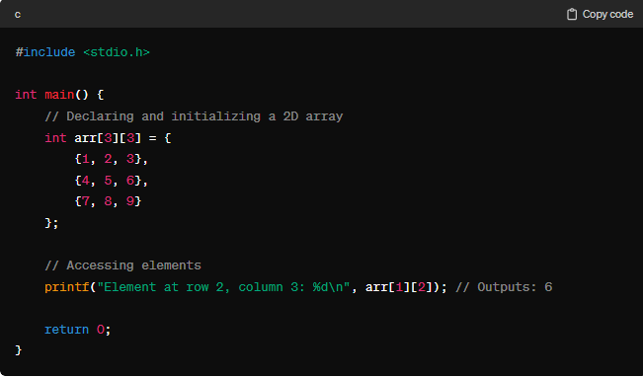
Two-Dimensional Array
Mr. Vikas Maral, Department of Computer engineering, VIT, Pune- 411037

Slide 37
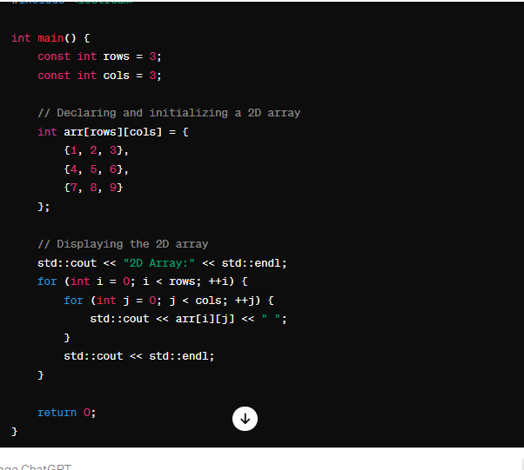
Two-Dimensional Array
Mr. Vikas Maral, Department of Computer engineering, VIT, Pune- 411037

Slide 38
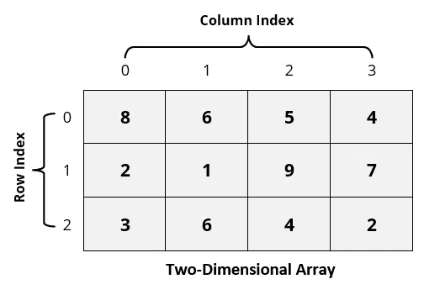
Storage Representation of 2D Array
While storing the elements of a 2-D array in memory, these are allocated contiguous memory locations.
2-D array must be linearized so as to enable their storage.
There are two alternatives to achieve linearization: Row-Major and Column-Major.
Mr. Vikas Maral, Department of Computer engineering, VIT, Pune- 411037

Slide 39
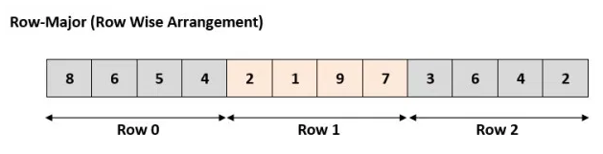
Row Major Representation
Mr. Vikas Maral, Department of Computer engineering, VIT, Pune- 411037

Slide 40
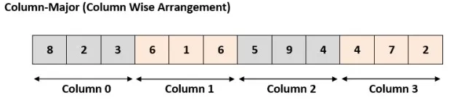
Column Major Representation
Mr. Vikas Maral, Department of Computer engineering, VIT, Pune- 411037

Slide 41
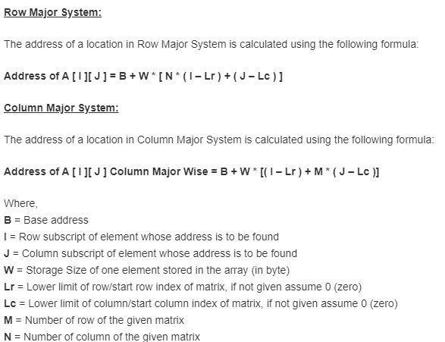
Address Calculation in 2D Array
Mr. Vikas Maral, Department of Computer engineering, VIT, Pune- 411037

Slide 42
Contd.. Address Calculation in 2D Array
Example
Assuming base address(B) to be 100 and W = 1 byte calculate the address of A[2][1] in row major arrangement
Mr. Vikas Maral, Department of Computer engineering, VIT, Pune- 411037

Slide 43
Contd.. Address Calculation in 2D Array
Example
Assuming base address(B) to be 100 and W = 1 byte calculate the address of A[2][1] in column major arrangement
Mr. Vikas Maral, Department of Computer engineering, VIT, Pune- 411037

Slide 44
Note
Usually number of rows and columns of a matrix are given ( like A[20][30] or A[40][60] )
If it is given as A[Lr- – – – – Ur, Lc- – – – – Uc], in this case number of rows and columns are calculated using the following methods:
Number of rows (M) will be calculated as = (Ur – Lr) + 1
Number of columns (N) will be calculated as = (Uc – Lc) + 1
Rest of the process will remain same as per requirement (Row Major Wise or Column Major Wise).
Mr. Vikas Maral, Department of Computer engineering, VIT, Pune- 411037

Slide 45
Exercise
Q 1. An array X [-15……….10] [15……………40] requires one byte of storage. If beginning location is 1500 determine the location of X [15][20].
Solution:
As you see here the number of rows and columns are not given in the question. So they are calculated as:
Number or rows say M = (Ur – Lr) + 1 = [10 – (- 15)] +1 = 26
Number or columns say N = (Uc – Lc) + 1 = [40 – 15)] +1 = 26
Mr. Vikas Maral, Department of Computer engineering, VIT, Pune- 411037

Slide 46
Exercise Solution
(i) Column Major Wise Calculation of above equation
The given values are: B = 1500, W = 1 byte, I = 15, J = 20, Lr = -15, Lc = 15, M = 26
Address of A [ I ][ J ] = B + W * [ ( I – Lr ) + M * ( J – Lc ) ]
= 1500 + 1 * [(15 – (-15)) + 26 * (20 – 15)]
= 1500 + 1 * [30 + 26 * 5] = 1500 + 1 * [160]
= 1660 [Ans]
(ii) Row Major Wise Calculation of above equation
The given values are: B = 1500, W = 1 byte, I = 15, J = 20, Lr = -15, Lc = 15, N = 26
Address of A [ I ][ J ] = B + W * [ N * ( I – Lr ) + ( J – Lc ) ]
= 1500 + 1* [26 * (15 – (-15))) + (20 – 15)]
= 1500 + 1 * [26 * 30 + 5] = 1500 + 1 * [780 + 5] = 1500 + 785
= 2285 [Ans]
Mr. Vikas Maral, Department of Computer engineering, VIT, Pune- 411037

Slide 47
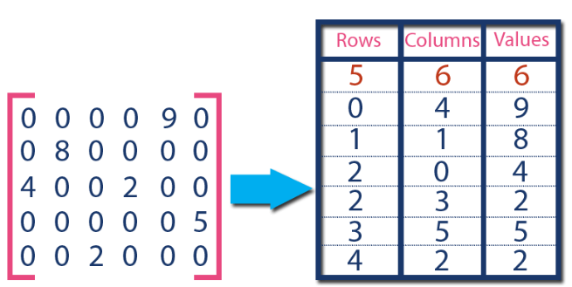
Sparse Matrices using Array
What is Sparse Matrix?
Sparse matrix is a matrix which contains very few non-zero elements.
Sparse Matrix Representations
A sparse matrix can be represented by using TWO representations, those are as follows...
  Triplet Representation (Array Representation)
  Linked Representation
Mr. Vikas Maral, Department of Computer engineering, VIT, Pune- 411037

Slide 48
Matrix Addition
 | 1 | 2 | 3
1 | 3 | 0 | 2
2 | 0 | 5 | 0
3 | 1 | 0 | 0
 | 1 | 2 | 3
1 | 0 | 13 | 10
2 | 0 | 0 | 0
3 | 8 | 0 | 4
 | 1 | 2 | 3
1 | 3 | 13 | 12
2 | 0 | 5 | 0
3 | 9 | 0 | 4
+
=
Mr. Vikas Maral, Department of Computer engineering, VIT, Pune- 411037

Slide 49
Sparse Matrix Addition
0 | 3 | 3 | 4
1 | 1 | 1 | 3
2 | 1 | 3 | 2
3 | 2 | 2 | 5
4 | 3 | 1 | 1
0 | 3 | 3 | 4
1 | 1 | 2 | 13
2 | 1 | 3 | 10
3 | 3 | 1 | 8
4 | 3 | 3 | 4
0 | 3 | 3 | 7
1 | 1 | 1 | 3
2 | 1 | 2 | 13
3 | 1 | 3 | 12
4 | 2 | 2 | 5
5 | 3 | 1 | 9
6 | 3 | 3 | 4
+
=
Mr. Vikas Maral, Department of Computer engineering, VIT, Pune- 411037

Slide 50
Matrix Transpose
 | 1 | 2 | 3
1 | 0 | 5 | 0
2 | 8 | 0 | 1
3 | 0 | 0 | 2
 | 1 | 2 | 3
1 | 0 | 8 | 0
2 | 5 | 0 | 0
3 | 0 | 1 | 2
➔
Mr. Vikas Maral, Department of Computer engineering, VIT, Pune- 411037

Slide 51
Sparse Matrix Simple Transpose
0 | 3 | 3 | 4
1 | 1 | 2 | 5
2 | 2 | 1 | 8
3 | 2 | 3 | 1
4 | 3 | 3 | 2
0 | 3 | 3 | 4
1 | 1 | 2 | 8
2 | 2 | 1 | 5
3 | 3 | 2 | 1
4 | 3 | 3 | 2
➔
Mr. Vikas Maral, Department of Computer engineering, VIT, Pune- 411037

Slide 52
Running Time Analysis of Simple Transpose
If there are n columns in m x n matrix and the number of non zero values are ‘t’, the total running time using simple transpose method is O(nt)
Mr. Vikas Maral, Department of Computer engineering, VIT, Pune- 411037

Slide 53
Sparse Matrix Fast Transpose
Number of elements in each column of A
Starting index of each row in T
1 | 2 | 3
1 | 2 | 1
1 | 2 | 3
1 | 2 | 4
0 | 3 | 3 | 4
1 | 1 | 2 | 5
2 | 2 | 1 | 8
3 | 3 | 2 | 1
4 | 3 | 3 | 2
0 | 3 | 3 | 4
1 | 1 | 2 | 8
2 | 2 | 1 | 5
3 | 2 | 3 | 1
4 | 3 | 3 | 2
➔
A
T
Mr. Vikas Maral, Department of Computer engineering, VIT, Pune- 411037

Slide 54
Fast Transpose Algorithm
Find the number of elements in column of A
This gives elements in each row of T
Using it, calculate starting position (index) of each row in T
Move each element of A one by one to its correct position in T
Mr. Vikas Maral, Department of Computer engineering, VIT, Pune- 411037

Slide 55
Fast Transpose –Pseudo Code
int i, j ,m, n, pos[3]={0,0,0},count[3]={0,0,0}
for i=1 to B[0][3]
m = B[i][2]
count[m]++
pos[0] = 1;
for i=1 to B[0][2]
pos[i] = pos [i-1] + count[i-1];
for i=1 to B[0][3]
m = B[i][2];
n= pos[m];
pos[m]++;
C[n][1] = B[i][2];
C[n][2] = B[i][1];
C[n][3] = B[i][3];
C[0][0] = B[0][0];
C[0][1] = B[0][1];
C[0][2] = B[0][2] ;
Mr. Vikas Maral, Department of Computer engineering, VIT, Pune- 411037

Slide 56
Running Time Analysis of Fast Transpose
Steps taken to find number of elements in each column of A = n (assuming m x n matrix)
Steps taken to compute starting positions of each row in transposed matrix T = n
Elements of original matrix are copied into T in t steps
Total steps = n+n+t = O(2n+t) = O(n+t)
If t is of order of nm, then running time for simple transpose becomes O(nm)
Mr. Vikas Maral, Department of Computer engineering, VIT, Pune- 411037

Slide 57
Polynomial representation using Array
Array representation assumes that the exponents of the given expression are arranged from 0 to the highest value (degree), which is represented by the subscript of the array beginning with 0.
The coefficients of the respective exponent are placed at an appropriate index in the array.
The array representation for the below polynomial expression P(x) = x² − 4x + 7 is
0 | 1 | 2
7 | -4 | 1
Mr. Vikas Maral, Department of Computer engineering, VIT, Pune- 411037

Slide 58
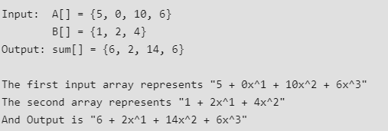
Polynomial Addition using Array
add(A[0..m-1], B[0..n01])
Create a sum array sum[] of size equal to maximum of 'm' and 'n‘
Copy A[] to sum[].
Traverse array B[] and do following for every element B[i]
sum[i] = sum[i] + B[i]
4) Return sum[].
Mr. Vikas Maral, Department of Computer engineering, VIT, Pune- 411037

Slide 59
Searching
Searching is a fundamental operation in computer science and data structures.
It involves finding a particular element within a collection of data. This could be locating a specific value in an array, a key in a dictionary, or an entry in a database.
In the context of data structures, there are various algorithms and techniques designed to efficiently perform searches, depending on the structure of the data.
Mr. Vikas Maral, Department of Computer engineering, VIT, Pune- 411037

Slide 60
Searching Examples
Problem: Suppose you have a sorted array of integers and you want to find the index of a particular number within the array.
Example Array: [2, 5, 8, 12, 16, 23, 38, 56, 72, 91]
Number to Search for: 23
Mr. Vikas Maral, Department of Computer engineering, VIT, Pune- 411037

Slide 61
Important of Searching
Searching is important for various reasons:
Data Retrieval: Searching allows us to retrieve specific information or elements from a large collection of data efficiently. Whether it's finding a contact in an address book, a book in a library, or a record in a database, searching enables us to access the desired information quickly.
Information Retrieval Systems: In information retrieval systems such as search engines, searching plays a critical role in retrieving relevant documents or web pages based on user queries. Efficient searching algorithms are essential for providing timely and accurate search results, which is crucial for user satisfaction.
Algorithm Design and Optimization: Searching algorithms are fundamental components of many other algorithms and data structures. Understanding and implementing efficient searching techniques are essential for designing optimized algorithms and systems across various domains, including computer science, engineering, and data analysis.
Database Operations: In databases, searching is essential for querying and retrieving data based on specific criteria. Efficient indexing and searching algorithms improve the performance of database operations, enabling faster data retrieval and processing.
Problem Solving: Searching algorithms are commonly encountered in problem-solving scenarios, such as pathfinding in graphs, scheduling tasks, and optimizing resource allocation. Efficient searching techniques contribute to solving complex problems effectively and finding optimal solutions.
Mr. Vikas Maral, Department of Computer engineering, VIT, Pune- 411037

Slide 62
Application of Searching
Web Search Engines: Search engines like Google, Bing, and Yahoo use sophisticated algorithms to retrieve relevant web pages in response to user queries These systems crawl the web, index web pages, and use complex ranking algorithms to present search results based on relevance, authority, and user preferences.
E-commerce Platforms: E-commerce websites like Amazon, eBay, and Alibaba rely heavily on searching to enable users to find products quickly Users can search for products by entering keywords, and the platform returns relevant results from a vast catalog of items. Advanced filtering and recommendation systems further enhance the searching experience by suggesting relevant products based on user preferences and browsing history.
Social Media Platforms: Social media platforms such as Facebook, Twitter, and LinkedIn use searching to help users find other users, posts, or topics of interest. Users can search for specific profiles, posts, hashtags, or topics, and the platform retrieves relevant content based on the search query.
Navigation and Maps: Navigation applications like Google Maps, Waze, and Apple Maps utilize searching to help users find locations, addresses, points of interest, and directions. Users can search for specific destinations, landmarks, businesses, or services, and the application provides navigation instructions and route suggestions.
Healthcare Systems: Healthcare systems and electronic health records (EHRs) use searching to retrieve patient records, medical histories, diagnostic reports, and treatment plans. Healthcare providers can search for specific patient information, lab results, medications, or medical images to aid diagnosis and treatment decisions.
Enterprise Search: Large organizations use enterprise search solutions to index and search internal documents, emails, presentations, and other digital assets. Employees can search for documents, files, or information stored across various systems and repositories, improving productivity and knowledge management.
Legal and Research Databases: Legal professionals and researchers use specialized search platforms to search for case law, statutes, regulations, scholarly articles, and other legal or academic documents. These platforms provide advanced search capabilities, including boolean operators, filters, and citation indexing, to facilitate precise and comprehensive searching.
Customer Support Systems: Customer support platforms use searching to help agents quickly find relevant information, FAQs, knowledge base articles, or previous support tickets related to customer inquiries. Searching enables efficient resolution of customer issues, reduces response times, and improves customer satisfaction.
Mr. Vikas Maral, Department of Computer engineering, VIT, Pune- 411037

Slide 63
How to Find Out
There are several techniques for searching data efficiently, each suited for different scenarios based on factors like data structure, size of the dataset, and the nature of the search. Here are some commonly used searching techniques
Linear Search
Binary Search
Mr. Vikas Maral, Department of Computer engineering, VIT, Pune- 411037

Slide 64
Linear Search
Linear search is a straightforward searching algorithm that iterates through each element of a collection (such as an array or a list) sequentially until the desired element is found or the end of the collection is reached. It is the simplest searching algorithm and is suitable for small datasets or unsorted collections.
Problem: Given an array of integers and a target element , If such a element exists, return their indices; otherwise, return -1.
Example:
Array: [5, 8, 12, 6, 3, 7]
Target Sum: 13
Expected Output: -1
Mr. Vikas Maral, Department of Computer engineering, VIT, Pune- 411037

Slide 65
Linear Search Algorithms
Algorithm:
Start from the first element of the collection.
Compare each element with the target element.
If the element matches the target, return its index.
If the element does not match, move to the next element.
Repeat steps 2-4 until the target is found or the end of the collection is reached.
If the target is not found after iterating through all elements, return -1 or an indication that the target is not present.
Mr. Vikas Maral, Department of Computer engineering, VIT, Pune- 411037

Slide 66
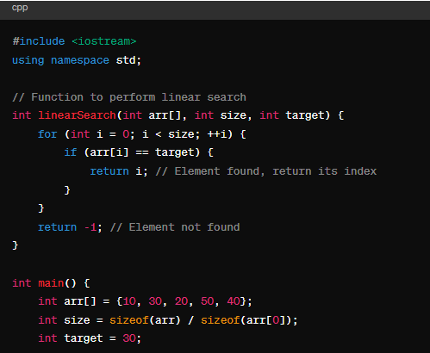
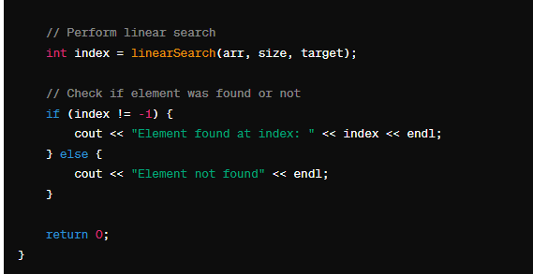
Linear Search Code
Mr. Vikas Maral, Department of Computer engineering, VIT, Pune- 411037

Slide 67
Time Complexity Linear Search
The time complexity of linear search is O(n), where n is the number of elements in the array.
Mr. Vikas Maral, Department of Computer engineering, VIT, Pune- 411037

Slide 68
Disadvantages of Linear Search
Time Complexity: The time complexity of linear search is O(n), where n is the number of elements in the array. This means that as the size of the array increases, the time taken by linear search also increases linearly. For large datasets, linear search may not be efficient compared to algorithms with better time complexities like binary search O(logn)).
Performance: Linear search may be slow for large datasets or when the target element is located towards the end of the array. This is because linear search needs to traverse the entire array sequentially, making n comparisons in the worst-case scenario.
Not Suitable for Sorted Data: Linear search does not require the data to be sorted beforehand. While this can be an advantage in some cases, it also means that linear search cannot take advantage of sorted data to improve efficiency. Algorithms like binary search are more suitable for sorted arrays due to their logarithmic time complexity.
Inefficient for Unsorted Data: Even though linear search can work on unsorted arrays, its performance is not optimized for such data. In scenarios where the data is unsorted, other searching algorithms may provide better performance.
No Early Termination: Linear search always needs to iterate through all elements of the array, even if the target element is found early in the search process. This lack of early termination can result in unnecessary comparisons, especially when the target element is located near the beginning of the array.
Not Suitable for Large Datasets: In applications where efficiency is critical, such as searching in large databases or real-time systems, linear search may not scale well due to its O(n) time complexity. More efficient searching algorithms are preferred in such cases.
Mr. Vikas Maral, Department of Computer engineering, VIT, Pune- 411037

Slide 69
Binary Search Algorithms
Binary Search is defined as a searching algorithm used in a sorted array by repeatedly dividing the search interval in half. The idea of binary search is to use the information that the array is sorted and reduce the time complexity to O(log N).
Mr. Vikas Maral, Department of Computer engineering, VIT, Pune- 411037

Slide 70
Steps of Binary Search
Sort the Array: Ensure that the array is sorted in ascending order. Binary search only works on sorted arrays
Initialize Pointers: Set two pointers, low and high, initially pointing to the start and end of the array, respectively.
Find the Midpoint: Calculate the midpoint of the array by averaging the low and high indices (using integer division).
Compare with the Target: Compare the value at the midpoint with the target value.
If the value at the midpoint is equal to the target, the search is successful. Return the index of the midpoint.
If the value at the midpoint is greater than the target, update the high pointer to just before the midpoint and repeat step 3
If the value at the midpoint is less than the target, update the low pointer to just after the midpoint and repeat step 3
5. Repeat: Continue steps 3 and 4 until the target value is found or the low pointer exceeds the high pointer.
6. Termination: If the pointers cross without finding the target value, the search terminates, and the target value is not in the array.
Mr. Vikas Maral, Department of Computer engineering, VIT, Pune- 411037

Slide 71
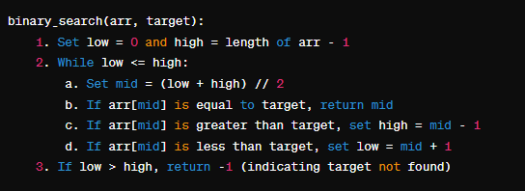
Algorithms for Binary Search
Mr. Vikas Maral, Department of Computer engineering, VIT, Pune- 411037

Slide 72
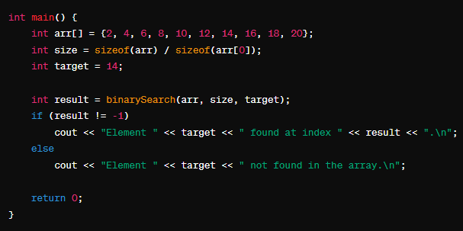
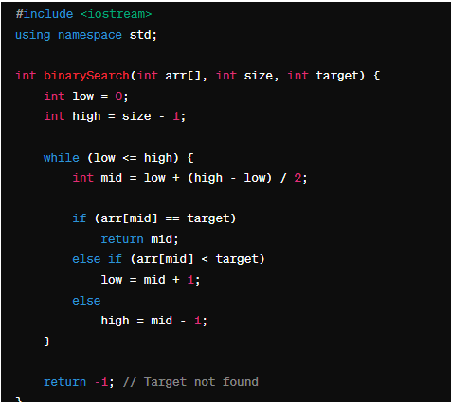
Code using C++
Mr. Vikas Maral, Department of Computer engineering, VIT, Pune- 411037

Slide 73
Importance Binary Search Algorithms
Efficiency: Binary search has a time complexity of O(log n), where n is the number of elements in the array. This makes it significantly faster than linear search, especially for large datasets. It's particularly useful when dealing with large collections of data where efficiency is critical.
Optimal Space Complexity: Binary search operates on the original array without requiring additional data structures, resulting in optimal space complexity. This makes it memory-efficient compared to other search algorithms that might need additional storage.
Versatility: Binary search is not limited to just arrays; it can also be adapted for use on other data structures like trees and graphs, provided they are sorted appropriately. This versatility allows its application in various contexts beyond simple array searching.
Simplicity: While binary search might seem complex at first, its underlying principles are relatively straightforward. Once understood, it's a concept that can be applied in various programming scenarios.
Applications: Binary search is extensively used in fields such as computer science, data analysis, database management, and more. It's employed in tasks ranging from searching for items in databases to locating elements in sorted collections.
Mr. Vikas Maral, Department of Computer engineering, VIT, Pune- 411037

Slide 74
Time Complexity Binary Search Algorithms
The time complexity of the binary search algorithm is O(log n), where n is the number of elements in the sorted array being searched.
Mr. Vikas Maral, Department of Computer engineering, VIT, Pune- 411037

Slide 75
Difference Between Linear and Binary Search
Feature | Linear Search | Binary Search
Approach | Sequentially scans each element in the array | Divides the search space by comparing with the middle element
Time Complexity | O(n) | O(log n)
Space Complexity | O(1) | O(1)
Sorted Data | Not required | Required
Applicability | Suitable for small datasets or unsorted data | Suitable for large datasets or sorted data
Performance | Slower, especially for large datasets | Faster, especially for large datasets
Implementation | Simple and easy to implement | More complex due to the need for sorted data
Mr. Vikas Maral, Department of Computer engineering, VIT, Pune- 411037

Slide 76
Sorting
Sorting is the process of arranging elements in a specific order, typically in ascending or descending order, based on some criteria such as numerical value, alphabetical order, or any other defined key. It is a fundamental operation in computer science and finds applications in various fields, including data processing, searching, and information retrieval.
The primary goal of sorting is to make data easier to search, analyze, and process efficiently. Efficient sorting algorithms are essential for optimizing various computational tasks and improving the performance of algorithms that rely on sorted data.
Mr. Vikas Maral, Department of Computer engineering, VIT, Pune- 411037

Slide 77
Types of Sorting
Types of Sorting Algorithms
Sorting algorithms can be categorized based on various criteria, including their complexity, memory usage, stability, and adaptability. Here are some common types of sorting algorithms:
Internal Sorting: Internal sorting algorithms are used to sort data stored in memory (RAM). These algorithms operate entirely within the main memory and do not require external storage devices.
  Comparison-based Sorting Algorithms: These algorithms compare elements pairwise to determine their relative order.
    Examples: Bubble Sort, Selection Sort, Insertion Sort, Merge Sort, Quick Sort, Heap Sort.
  Non-comparison-based Sorting Algorithms: These algorithms do not rely on pairwise comparisons between elements.
    Examples: Counting Sort, Radix Sort, Bucket Sort.
External Sorting: External sorting algorithms are used to sort data that is too large to fit entirely into the main memory. They involve reading and writing data to external storage devices such as hard disks.
  Merge Sort with External Storage: Merge Sort is commonly used for external sorting due to its ability to efficiently merge sorted sublists from external storage.
Mr. Vikas Maral, Department of Computer engineering, VIT, Pune- 411037

Slide 78
Bubble Sort
Bubble Sort is the simplest sorting algorithm that works by repeatedly swapping the adjacent elements if they are in the wrong order. This algorithm is not suitable for large data sets as its average and worst-case time complexity is quite high.
Bubble Sort Algorithm
In Bubble Sort algorithm,
Traverse from left and compare adjacent elements and the higher one is placed at right side.
In this way, the largest element is moved to the rightmost end at first.
This process is then continued to find the second largest and place it and so on until the data is sorted.
Let us understand the working of bubble sort with the help of the following illustration:
Input: arr[] = {6, 3, 0, 5}
First Pass:
The largest element is placed in its correct position, i.e., the end of the array.
Mr. Vikas Maral, Department of Computer engineering, VIT, Pune- 411037

Slide 79
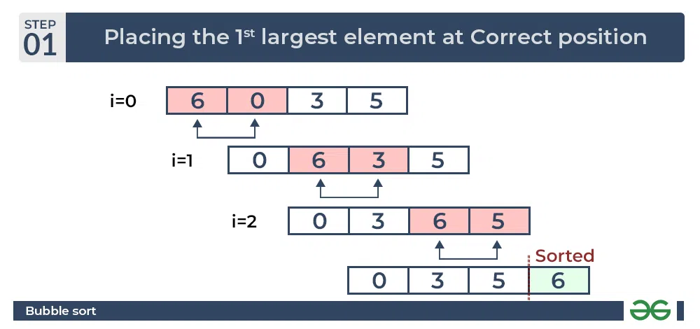
Bubble Sort
Mr. Vikas Maral, Department of Computer engineering, VIT, Pune- 411037

Slide 80
Advantages Bubble Sort
Advantages of Bubble Sort:
Bubble sort is easy to understand and implement.
It does not require any additional memory space.
It is a stable sorting algorithm, meaning that elements with the same key value maintain their relative order in the sorted output.
Mr. Vikas Maral, Department of Computer engineering, VIT, Pune- 411037

Slide 81
Algorithms Bubble Sort
Start with an unsorted array of elements.
Comparison: Compare adjacent elements in the array.
Swap: If the elements are in the wrong order (e.g., the first element is greater than the second), swap them.
Traversal: Move through the array and repeat steps 2 and 3 until the end of the array is reached.
Iteration: Repeat the traversal process multiple times (n-1 times for an array of size n) until the array is sorted.
Completion: The array is now sorted.
Mr. Vikas Maral, Department of Computer engineering, VIT, Pune- 411037

Slide 82
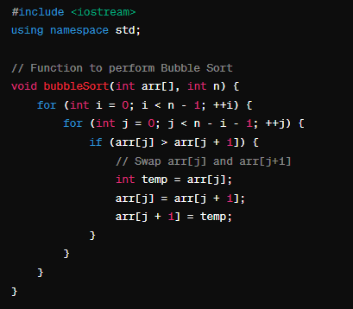
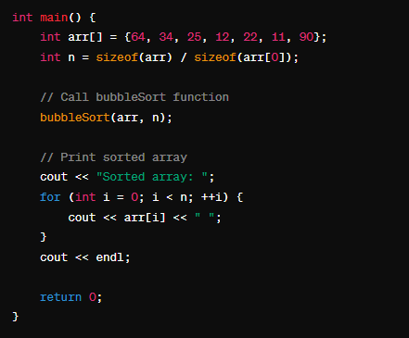
Bubble Sort
Mr. Vikas Maral, Department of Computer engineering, VIT, Pune- 411037

Slide 83
Disadvantages Bubble Sort
Poor Time Complexity:
Inefficiency with Large Datasets:
Inefficiency with Nearly Sorted Arrays:
4. Not Suitable for Real-world Applications:
Mr. Vikas Maral, Department of Computer engineering, VIT, Pune- 411037

Slide 84
Selection Sort
Selection sort is a simple and efficient sorting algorithm that works by repeatedly selecting the smallest (or largest) element from the unsorted portion of the list and moving it to the sorted portion of the list.
The algorithm repeatedly selects the smallest (or largest) element from the unsorted portion of the list and swaps it with the first element of the unsorted part. This process is repeated for the remaining unsorted portion until the entire list is sorted.
Mr. Vikas Maral, Department of Computer engineering, VIT, Pune- 411037

Slide 85
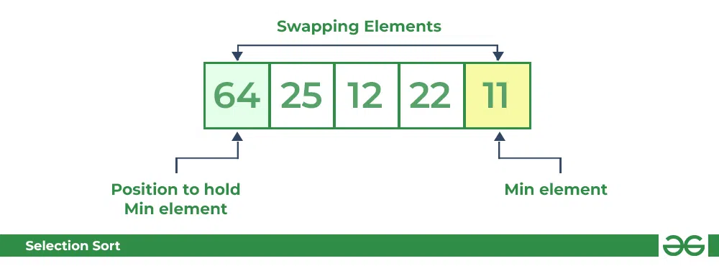
Selection Sort
How does Selection Sort Algorithm work?
Lets consider the following array as an example: arr[] = {64, 25, 12, 22, 11}
First pass:
For the first position in the sorted array, the whole array is traversed from index 0 to 4 sequentially. The first position where 64 is stored presently, after traversing whole array it is clear that 11 is the lowest value.
Thus, replace 64 with 11. After one iteration 11, which happens to be the least value in the array, tends to appear in the first position of the sorted list.
Mr. Vikas Maral, Department of Computer engineering, VIT, Pune- 411037

Slide 86
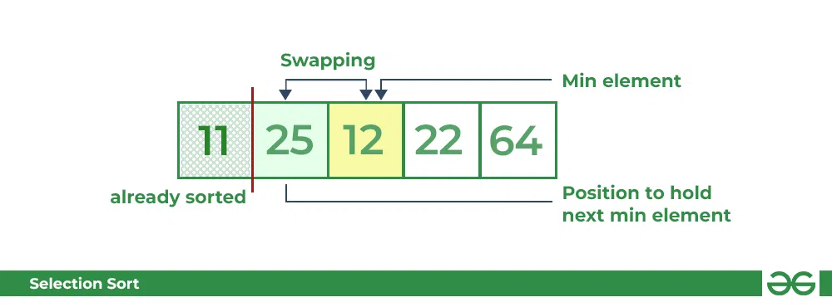
Selection Sort
Second Pass:
For the second position, where 25 is present, again traverse the rest of the array in a sequential manner.
After traversing, we found that 12 is the second lowest value in the array and it should appear at the second place in the array, thus swap these values.
Mr. Vikas Maral, Department of Computer engineering, VIT, Pune- 411037

Slide 87
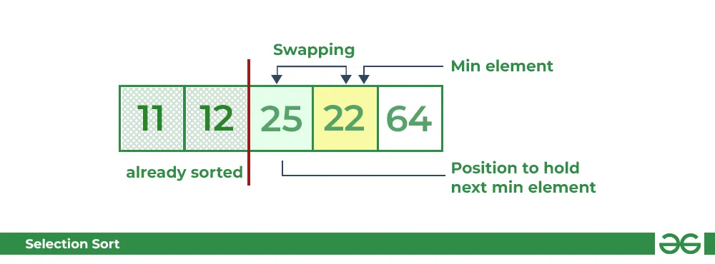
Selection Sort
Third Pass:
Now, for third place, where 25 is present again traverse the rest of the array and find the third least value present in the array.
While traversing, 22 came out to be the third least value and it should appear at the third place in the array, thus swap 22 with element present at third position.
Mr. Vikas Maral, Department of Computer engineering, VIT, Pune- 411037

Slide 88
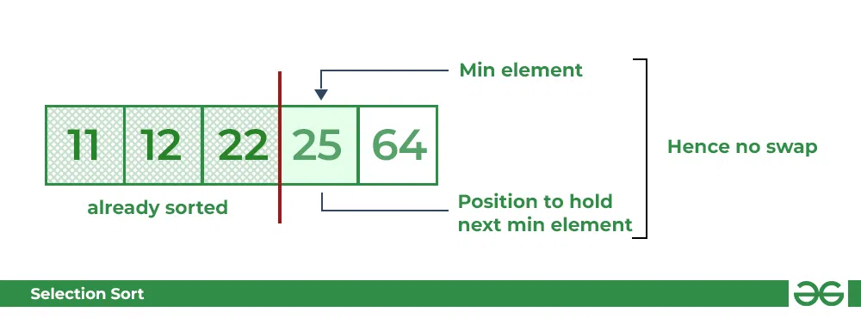
Selection Sort
Fourth pass:
Similarly, for fourth position traverse the rest of the array and find the fourth least element in the array
As 25 is the 4th lowest value hence, it will place at the fourth position.
Mr. Vikas Maral, Department of Computer engineering, VIT, Pune- 411037

Slide 89
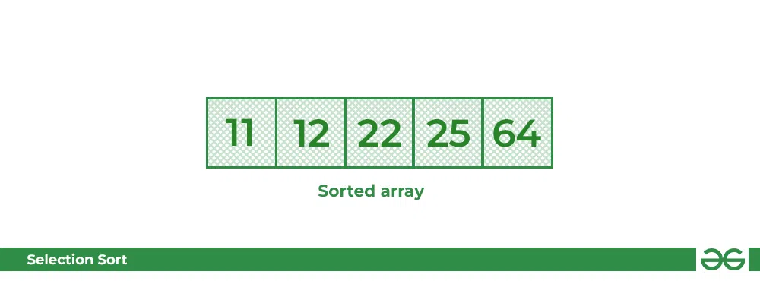
Selection Sort
Fifth Pass:
At last the largest value present in the array automatically get placed at the last position in the array
The resulted array is the sorted array.
Mr. Vikas Maral, Department of Computer engineering, VIT, Pune- 411037

Slide 90
Selection Sort
Advantages of Selection Sort Algorithm
Simple and easy to understand.
Works well with small datasets.
Mr. Vikas Maral, Department of Computer engineering, VIT, Pune- 411037

Slide 91
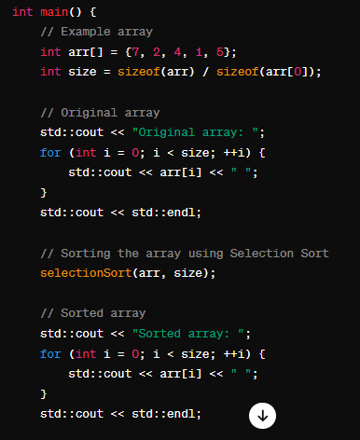
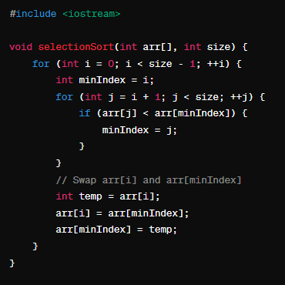
Selection Sort
Mr. Vikas Maral, Department of Computer engineering, VIT, Pune- 411037

Slide 92
Insertion Sort
To sort an array of size N in ascending order iterate over the array and compare the current element (key) to its predecessor, if the key element is smaller than its predecessor, compare it to the elements before. Move the greater elements one position up to make space for the swapped element.
Working of Insertion Sort algorithm
Consider an example: arr[]: {12, 11, 13, 5, 6}
12 | 11 | 13 | 5 | 6
First Pass:
Initially, the first two elements of the array are compared in insertion sort.
12 | 11 | 13 | 5 | 6
Here, 12 is greater than 11 hence they are not in the ascending order and 12 is not at its correct position. Thus, swap 11 and 12.
So, for now 11 is stored in a sorted sub-array.
11 | 12 | 13 | 5 | 6
Mr. Vikas Maral, Department of Computer engineering, VIT, Pune- 411037

Slide 93
Second Pass:
Now, move to the next two elements and compare them
11 | 12 | 13 | 5 | 6
Here, 13 is greater than 12, thus both elements seems to be in ascending order, hence, no swapping will occur. 12 also stored in a sorted sub-array along with 11
Third Pass:
Now, two elements are present in the sorted sub-array which are 11 and 12 Moving forward to the next two elements which are 13 and 5
11 | 12 | 13 | 5 | 6
Both 5 and 13 are not present at their correct place so swap them
11 | 12 | 5 | 13 | 6
After swapping, elements 12 and 5 are not sorted, thus swap again
11 | 5 | 12 | 13 | 6

Slide 94
Here, again 11 and 5 are not sorted, hence swap again
5 | 11 | 12 | 13 | 6
Here, 5 is at its correct position
Fourth Pass:
Now, the elements which are present in the sorted sub-array are 5, 11 and 12
Moving to the next two elements 13 and 6
5 | 11 | 12 | 13 | 6
Clearly, they are not sorted, thus perform swap between both
5 | 11 | 12 | 6 | 13
Now, 6 is smaller than 12, hence, swap again
5 | 11 | 6 | 12 | 13
Mr. Vikas Maral, Department of Computer engineering, VIT, Pune- 411037

Slide 95

Here, also swapping makes 11 and 6 unsorted hence, swap again
5 | 6 | 11 | 12 | 13
Finally, the array is completely sorted.
Mr. Vikas Maral, Department of Computer engineering, VIT, Pune- 411037

Slide 96
Characteristics of Insertion Sort
This algorithm is one of the simplest algorithms with a simple implementation
Basically, Insertion sort is efficient for small data values
Insertion sort is adaptive in nature, i.e. it is appropriate for data sets that are already partially sorted.
Mr. Vikas Maral, Department of Computer engineering, VIT, Pune- 411037

Slide 97
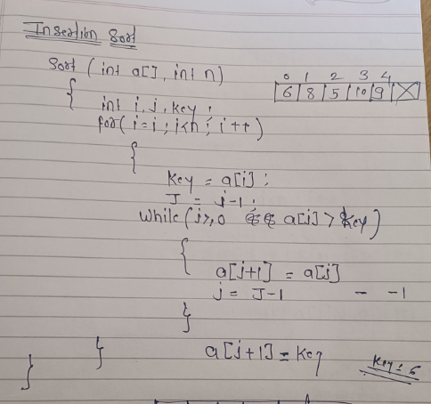
Mr. Vikas Maral, Department of Computer engineering, VIT, Pune- 411037

Slide 98
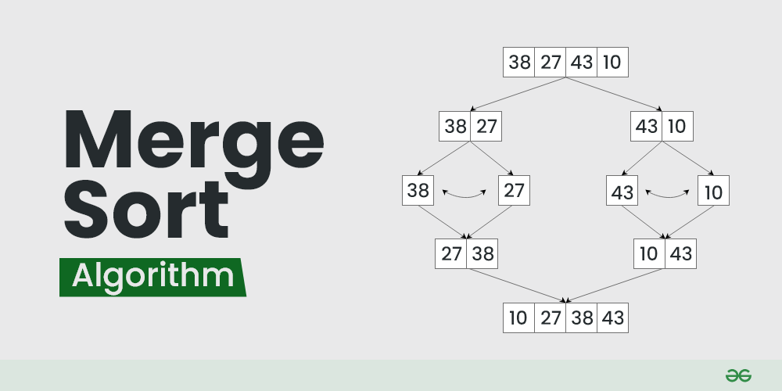
Merge Sort
Merge sort is defined as a sorting algorithm that works by dividing an array into smaller subarrays, sorting each subarray, and then merging the sorted subarrays back together to form the final sorted array.
In simple terms, we can say that the process of merge sort is to divide the array into two splits, sort each half, and then merge the sorted splits back together. This process is repeated until the entire array is sorted.
Mr. Vikas Maral, Department of Computer engineering, VIT, Pune- 411037

Slide 99
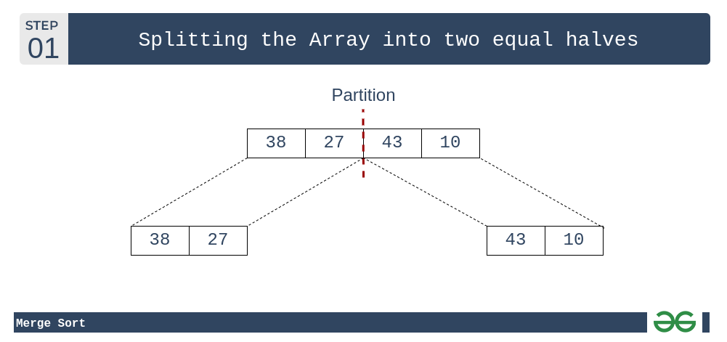
Merge Sort
How does Merge Sort work?
Merge sort is a recursive algorithm that continuously splits the array in half until it cannot be further divided i.e., the array has only one element left (an array with one element is always sorted). Then the sorted subarrays are merged into one sorted array.
Lets consider an array arr[] = {38, 27, 43, 10}
Initially divide the array into two equal splits:
Mr. Vikas Maral, Department of Computer engineering, VIT, Pune- 411037

Slide 100
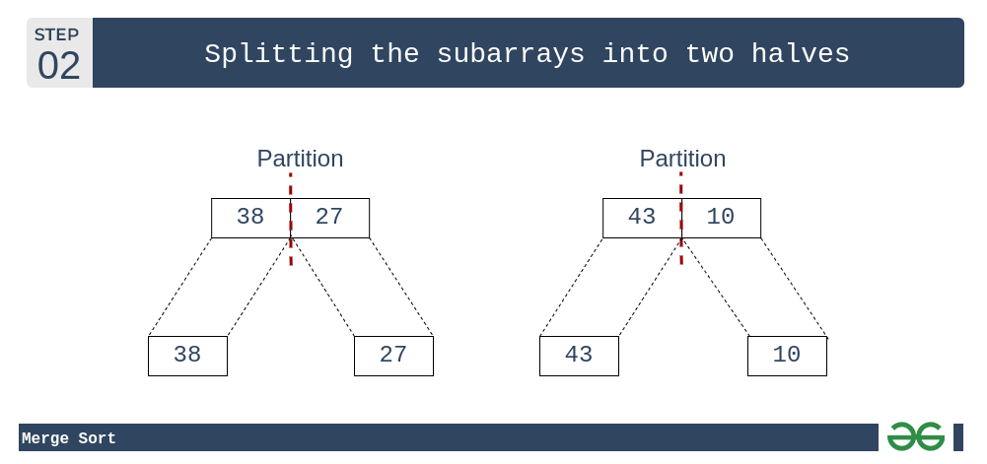
Merge Sort
Step 2: These subarrays are further divided into two halves. Now they become array of unit length that can no longer be divided and array of unit length are always sorted.
Mr. Vikas Maral, Department of Computer engineering, VIT, Pune- 411037

Slide 101

Merge Sort
Step 3: These sorted subarrays are merged together, and we get bigger sorted subarrays.
Mr. Vikas Maral, Department of Computer engineering, VIT, Pune- 411037

Slide 102
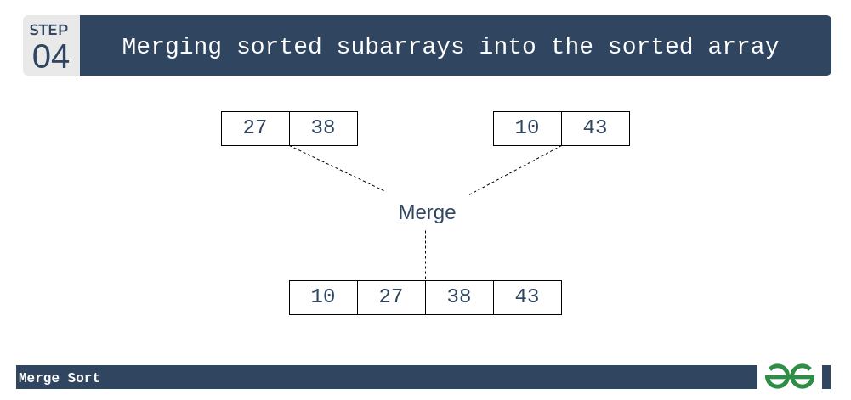
Merge Sort
The following diagram shows the complete merge sort process for an example array {38, 27, 43, 10}.
Mr. Vikas Maral, Department of Computer engineering, VIT, Pune- 411037

Slide 103
Merge Sort
Merge Sort is a classic sorting algorithm that follows the divide-and-conquer approach. Here's a step-by-step explanation of how the algorithm works:
Divide: The unsorted list is divided into two halves recursively until each sub list contains only one element.
Conquer: Once the lists are divided into individual elements, they are merged back together in a sorted manner.
Merge: During the merge step, the two smaller sorted lists are merged into a single larger sorted list. This process continues recursively until there is only one sorted list remaining, which is the sorted version of the original list.
Mr. Vikas Maral, Department of Computer engineering, VIT, Pune- 411037

Slide 104
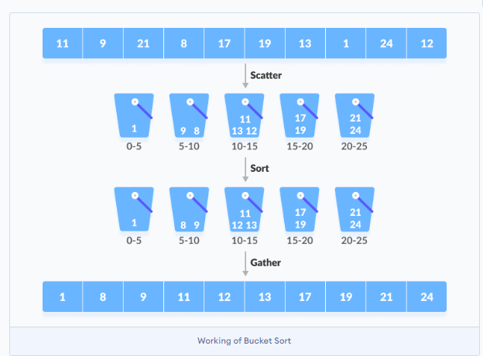
Bucket Sort
Bucket Sort is a sorting algorithm that divides the unsorted array elements into several groups called buckets. Each bucket is then sorted by using any of the suitable sorting algorithms or recursively applying the same bucket algorithm.
Finally, the sorted buckets are combined to form a final sorted array.
Scatter Gather Approach
The process of bucket sort can be understood as a scatter-gather approach. Here, elements are first scattered into buckets then the elements in each bucket are sorted. Finally, the elements are gathered in order.
Mr. Vikas Maral, Department of Computer engineering, VIT, Pune- 411037

Slide 105
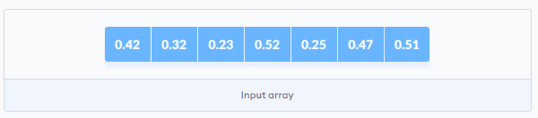
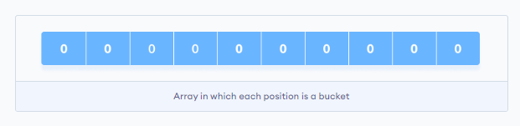
Working of Bucket Sort
Suppose, the input array is:
Create an array of size 10. Each slot of this array is used as a bucket for storing elements.
Mr. Vikas Maral, Department of Computer engineering, VIT, Pune- 411037

Slide 106

Working of Bucket Sort
Insert elements into the buckets from the array. The elements are inserted according to the range of the bucket.
In our example code, we have buckets each of ranges from 0 to 1, 1 to 2, 2 to 3,...... (n-1) to n.
Suppose, an input element is .23 is taken. It is multiplied by size = 10 (ie. .23*10=2.3). Then, it is converted into an integer (ie. 2.3≈2). Finally, .23 is inserted into bucket-2
Mr. Vikas Maral, Department of Computer engineering, VIT, Pune- 411037

Slide 107

Working of Bucket Sort
Similarly, .25 is also inserted into the same bucket. Every time, the floor value of the floating point number is taken. If we take integer numbers as input, we have to divide it by the interval (10 here) to get the floor value. Similarly, other elements are inserted into their respective buckets.
Mr. Vikas Maral, Department of Computer engineering, VIT, Pune- 411037

Slide 108


Working of Bucket Sort
The elements of each bucket are sorted using any of the stable sorting algorithms. Here, we have used quicksort (inbuilt function).
The elements from each bucket are gathered. It is done by iterating through the bucket and inserting an individual element into the original array in each cycle. The element from the bucket is erased once it is copied into the original array.
Mr. Vikas Maral, Department of Computer engineering, VIT, Pune- 411037

Slide 109


Algorithms of Bucket Sort
Mr. Vikas Maral, Department of Computer engineering, VIT, Pune- 411037

Slide 110
Quick Sort
Quicksort is a sorting algorithm based on the divide and conquer approach where
1. An array is divided into subarrays by selecting a pivot element (element selected from the array). While dividing the array, the pivot element should be positioned in such a way that elements less than pivot are kept on the left side and elements greater than pivot are on the right side of the pivot.
2. The left and right subarrays are also divided using the same approach. This process continues until each subarray contains a single element.
3. At this point, elements are already sorted. Finally, elements are combined to form a sorted array.
Pick the middle as the pivot.
Always pick the last element as a pivot.
There are many different choices for picking pivots.
Always pick the first element as a pivot.
Pick a random element as a pivot.
Mr. Vikas Maral, Department of Computer engineering, VIT, Pune- 411037

Slide 111


Working of Quick Sort
1. Select the Pivot Element
There are different variations of quicksort where the pivot element is selected from different positions. Here, we will be selecting the rightmost element of the array as the pivot element.
Rearrange the Array
Now the elements of the array are rearranged so that elements that are smaller than the pivot are put on the left and the elements greater than the pivot are put on the right.
Mr. Vikas Maral, Department of Computer engineering, VIT, Pune- 411037

Slide 112

Working of Quick Sort
Now, pivot is compared with other elements. If an element smaller than the pivot element is reached, the smaller element is swapped with the greater element found earlier.
Mr. Vikas Maral, Department of Computer engineering, VIT, Pune- 411037

Slide 113


Working of Quick Sort
Again, the process is repeated to set the next greater element as the second pointer. And, swap it with another smaller element.
The process goes on until the second last element is reached.
Mr. Vikas Maral, Department of Computer engineering, VIT, Pune- 411037

Slide 114

Working of Quick Sort
Finally, the pivot element is swapped with the second pointer.
Mr. Vikas Maral, Department of Computer engineering, VIT, Pune- 411037

Slide 115

Working of Quick Sort
3. Divide Subarrays
Pivot elements are again chosen for the left and the right sub-parts separately. And, step 2 is repeated
Mr. Vikas Maral, Department of Computer engineering, VIT, Pune- 411037

Slide 116

Working of Quick Sort
Mr. Vikas Maral, Department of Computer engineering, VIT, Pune- 411037

Slide 117

Comparison of Complexities of all sorting techniques.
Mr. Vikas Maral, Department of Computer engineering, VIT, Pune- 411037

Slide 118
Thank You
Mr. Vikas Maral, Department of Computer engineering, VIT, Pune- 411037

